Slide 1
HACK THE MOUNTAIN 2.0
PROJECT NAME:
E-COMMERCE WEBSITE FOR FARMERS

Slide 2
PROBLEMS FACED BY FARMERS Looting Middlemen – Most of the farmers are left with small volume of the produce. Taking them to government mandi will be burden as transport ion coats, storage costs adds up. So they sell it to middlemen at distress price. The middlemen will make it to the mandi and get lucrative prices that is often not shared with farmers.

Slide 3
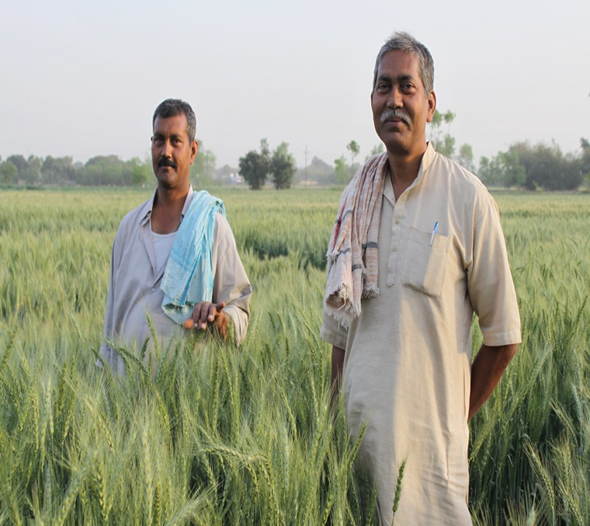
Aim of the site : To develop a platform for direct framing between farmers and consumers .
Perks of the site : Through this website the role of middlemen will be deduced during the whole process . Farmers can demand upto any reasonable amount by having the direct contact with the consumers .

